Slide 1
How to calculate driving distance from water points

Slide 2
Please copy .model3 file and .qml file under modelbuilder folder to QGIS3 application directory.
%userprofile%\AppData\Roaming\QGIS\QGIS3\profiles\default\processing\models

Slide 3
Please install and enable QNEAT3 plugin from “Plugins > Manage and Install plugins”.
Double-click QGIS project file under the folder to launch QGIS3.

Slide 4
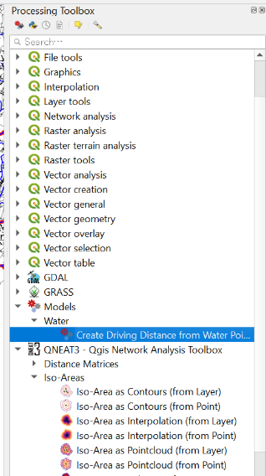
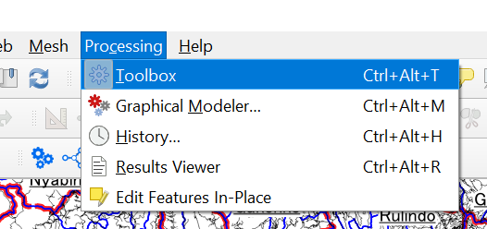
Open Processing Toolbox from menu.
Double-click and launch customized processing tool “Create Driving Distance from Water Points”.

Slide 5
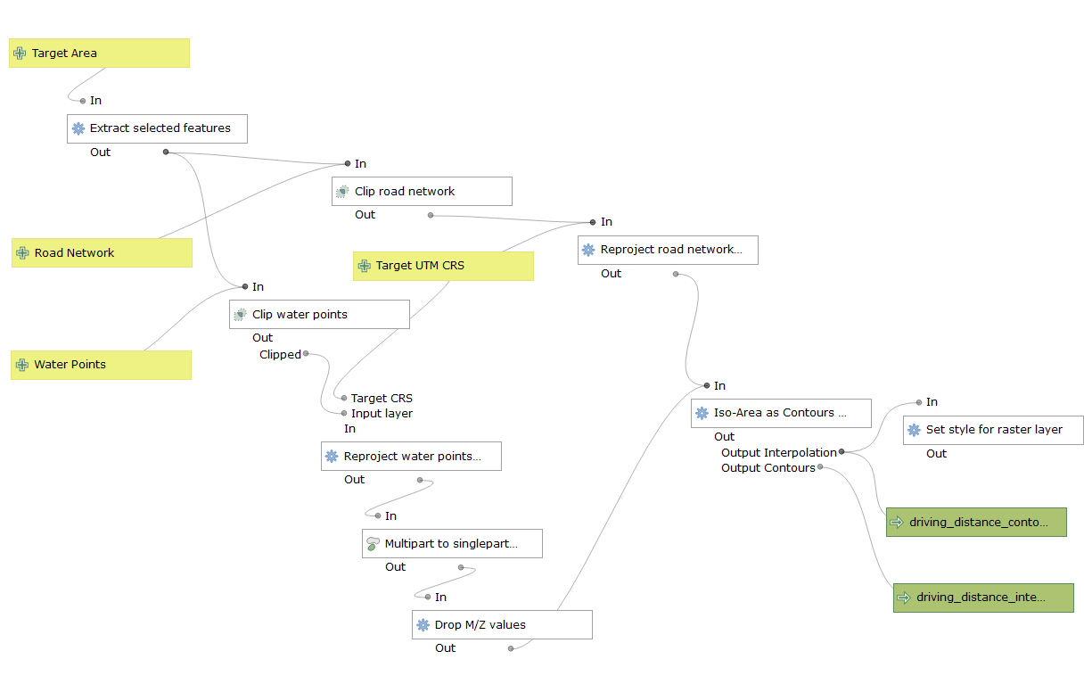
Extract only selected feature from target polygon layer
Clip road network data by selected target area
It’s function of QNEAT3 to calculate driving distance from water points based on newtowk data, then it create TIFF image.
Change CRS from WGS84 to UTM36S
Change CRS from WGS84 to UTM36S
Clip water points data by selected target area
Change geometry type from multipointz to pointz
Outputs from this customized modeler.
Remove Z values from pointz geometry

Slide 6
Select targeted sector on QGIS. If you selected large area, it might take much time for calculating.

Slide 7
Run customized modeler to calculate water access area.

Slide 8
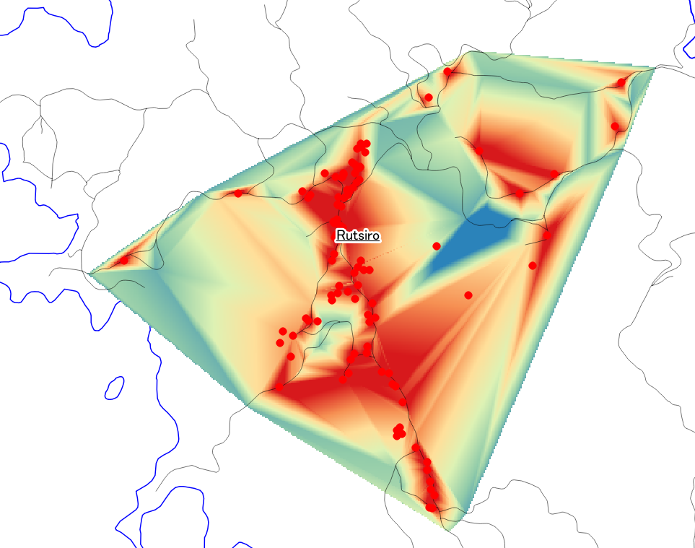
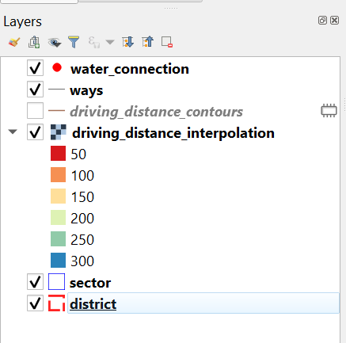
This area without any colored, there is no water access completely.
ways layer is current road data from openstreet map. You may use other road network data. It is better to use detailed network data if possible.
Unit is meter
The more red, the easier it is to access the water supply point

Slide 9
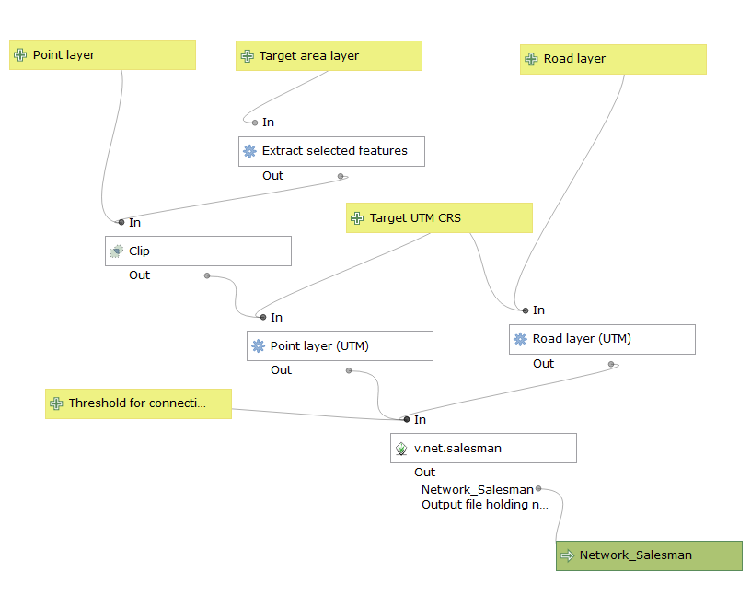
Extract only selected feature from target polygon layer
Clip water points data by selected target area
Change CRS from WGS84 to UTM36S
Change CRS from WGS84 to UTM36S
It’s function of GRASS, so you cannot use this modeler if you launch QGIS without GRASS tool.

